Slide 1

OCTAL TO BINARY ENCODER DIGITAL ELECTRONICS (ECE 213) By MUKESH KUMAR SAH REGISTRATION NUMBER: 11719859 ROLL NUMBER: RK17CSB49 SECTION: K17CS D.MANIDEEP Submitted To Geetika, Assistant Professor SCHOOL OF COMPUTER SCIENCE & ENGINEERING LOVELY PROFESSIONAL UNIVERSITY, JALANDHAR APRIL-2018

Slide 2
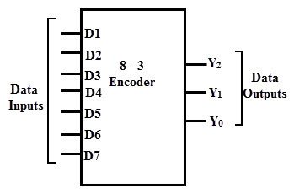
Encoders is a digital circuit whose input is decimal digit or alphabetic characters or symbols and output is in the coded representation form of the input. i.e, It converts human language to machine language. There is 2^{n} input lines and n-bit output lines. It encodes the given information into a more compact form.

Slide 3
In other words, it is a combinational circuit that performs the opposite function of a decoder. These are mainly used to reduce the number of bits needed to represent given information. In digital systems, Encoders are used for transmitting the information. Thus, the transmission link uses fewer lines to transmit the encoded information. In addition, these encoders are used for encoding the data which is to be stored for later use as it facilitates fewer bits storing over the available space.

Slide 4
TYPES OF ENCODER: 1.Octal to Binary 2.Decimal to BCD 3.Priority Encoder Octal to Binary: An octal to binary encoder consists of eight input lines and three output lines. Each input line corresponds to each octal digit and three outputs generate corresponding binary code. In encoders, it is to be assumed that only one input is active or has a value 1 at any given time otherwise the circuit has no meaning.

Slide 5
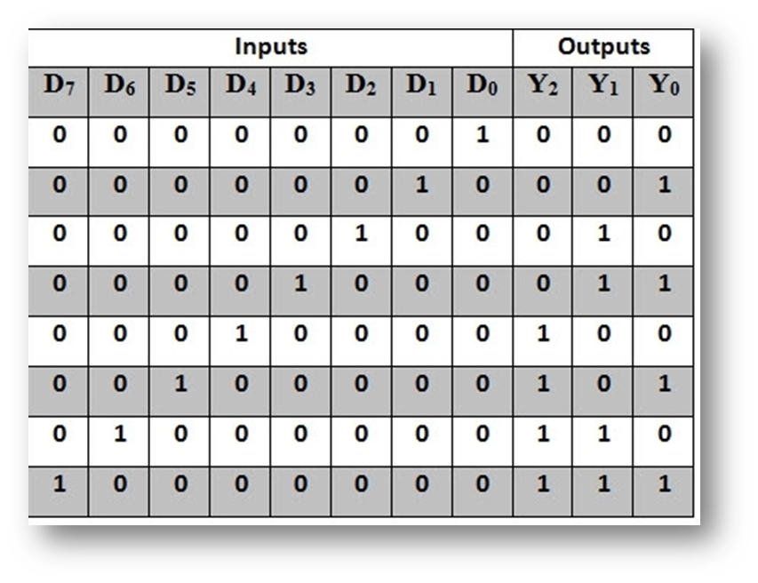
74148 OCTAL TO BINARY ENCODER TRUTH TABLE

Slide 6
From the above table, the output Y2 becomes 1 if any of the digits D4 or D5 or D6 or D7 is one. Thus, we can write its expression as: Y2 = D4 + D5 + D6 + D7 Similarly, Y1 = D2 + D3 + D6 + D7 and Y0 = D1 + D3 + D5 + D7 Also, it is to be observed that D0 does not exist in any of the expressions so it is considered as don’t care. From the above expressions, we can implement the octal to binary encoder using set of OR gates as shown in figure below.

Slide 7
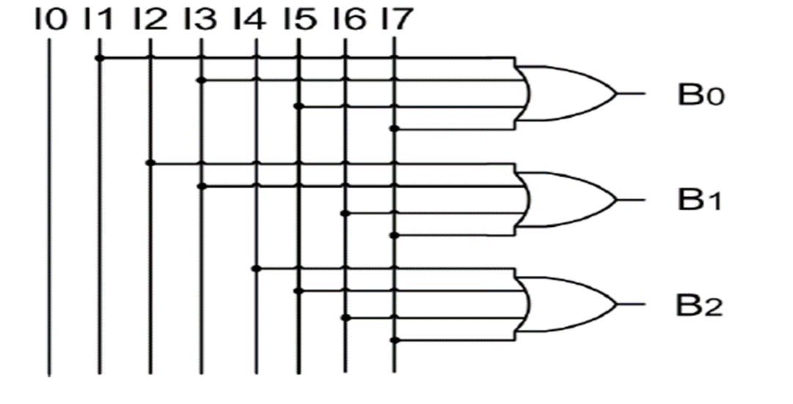
There is ambiguity in the octal to binary encoder that when all the inputs are zero, an output with all 0’s is generated. Also, when Do is 1, the output generated is zero. This is a major problem in this type of encoder. This can be resolved by specifying the condition that none of the inputs are active with an additional output.

Slide 8
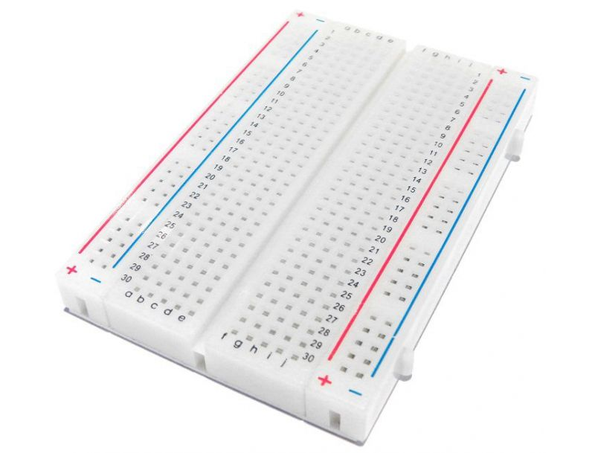
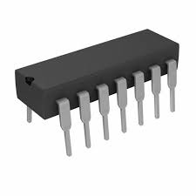
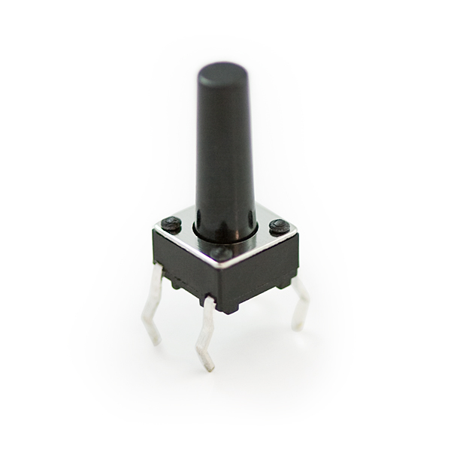
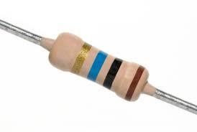
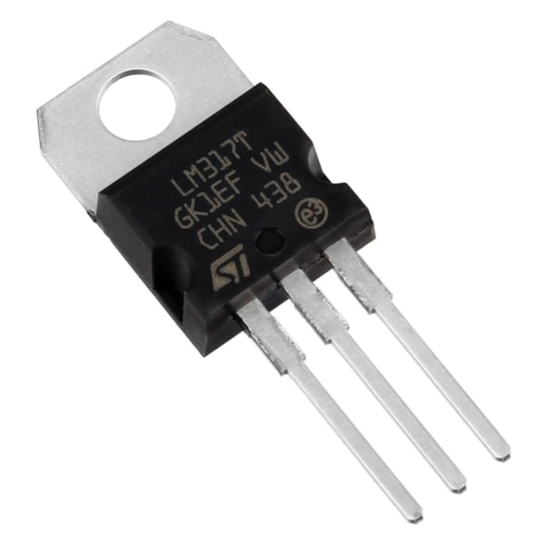
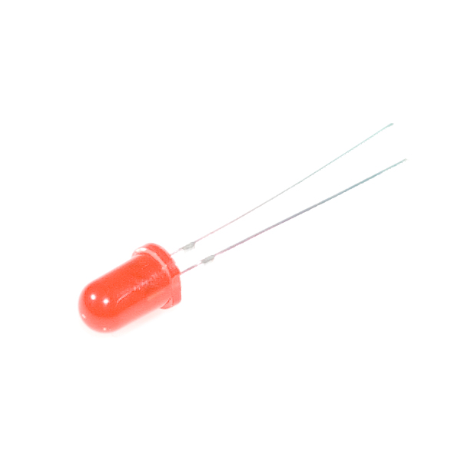
COMPONENTS USED IN THE PROJECT: 1.BreadBoard 2.IC 74148 3.Resistor (100 Ohms) 4.LEDs 5.Battery (9v) 6.Push buttons switches 7.Connecting wires 8.Voltage Regulator ( LM317 )

Slide 9
SUMMARY: Encoders are very common electronic circuits used in all digital systems. In case of calculators, these are used to translate the decimal values to the binary in order to perform the binary functions such as addition, subtraction, multiplication, etc.

Slide 10
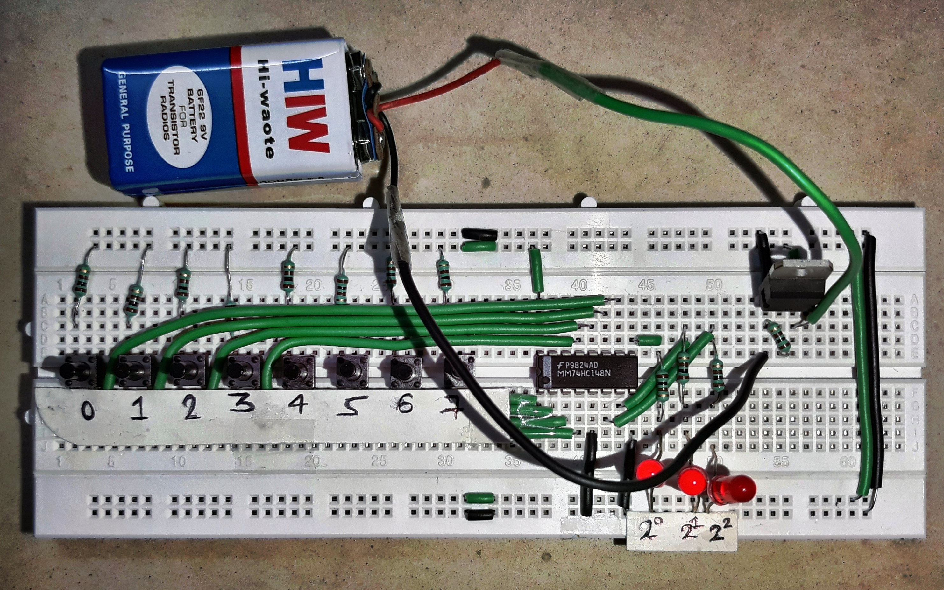
THANK YOU-

